Slide 1
Launching
of
Basic Course in Entrepreneurship Organized by
S.K.Patel Institute of Management and Computer Studies, MBA
In Association With
Date – 2nd August, 2018

Slide 2
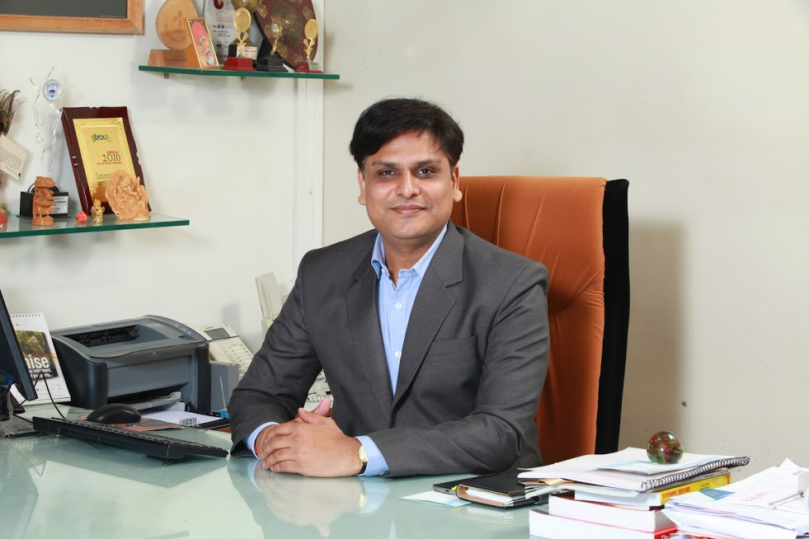
Dr. Bhavin Pandya
Dean Faculty of Management
Kadi Sarva Vishwavidhyalaya

Slide 3
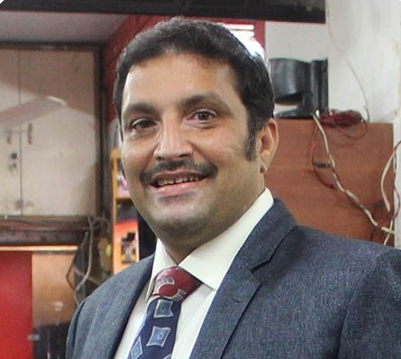
Mr. Nadeem Jafri
Founder & Chief Mentor,
Hearty Mart

